Slide 2
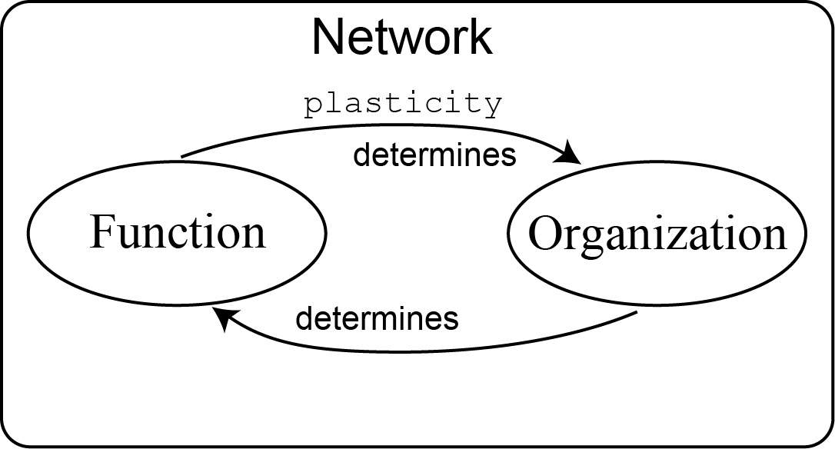
Environment, Organism and Plasticity

Slide 3
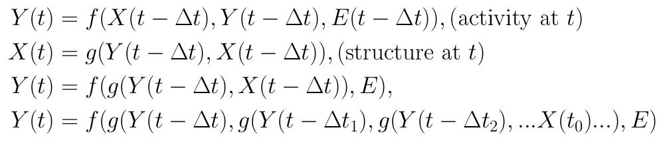
Environment, Organism and Plasticity
Activity changes organization (structure) changes activity …
Y(t) : activity at time t;
X(t) : organization / structure at time t;
E : environmental impact at time t;

Slide 4
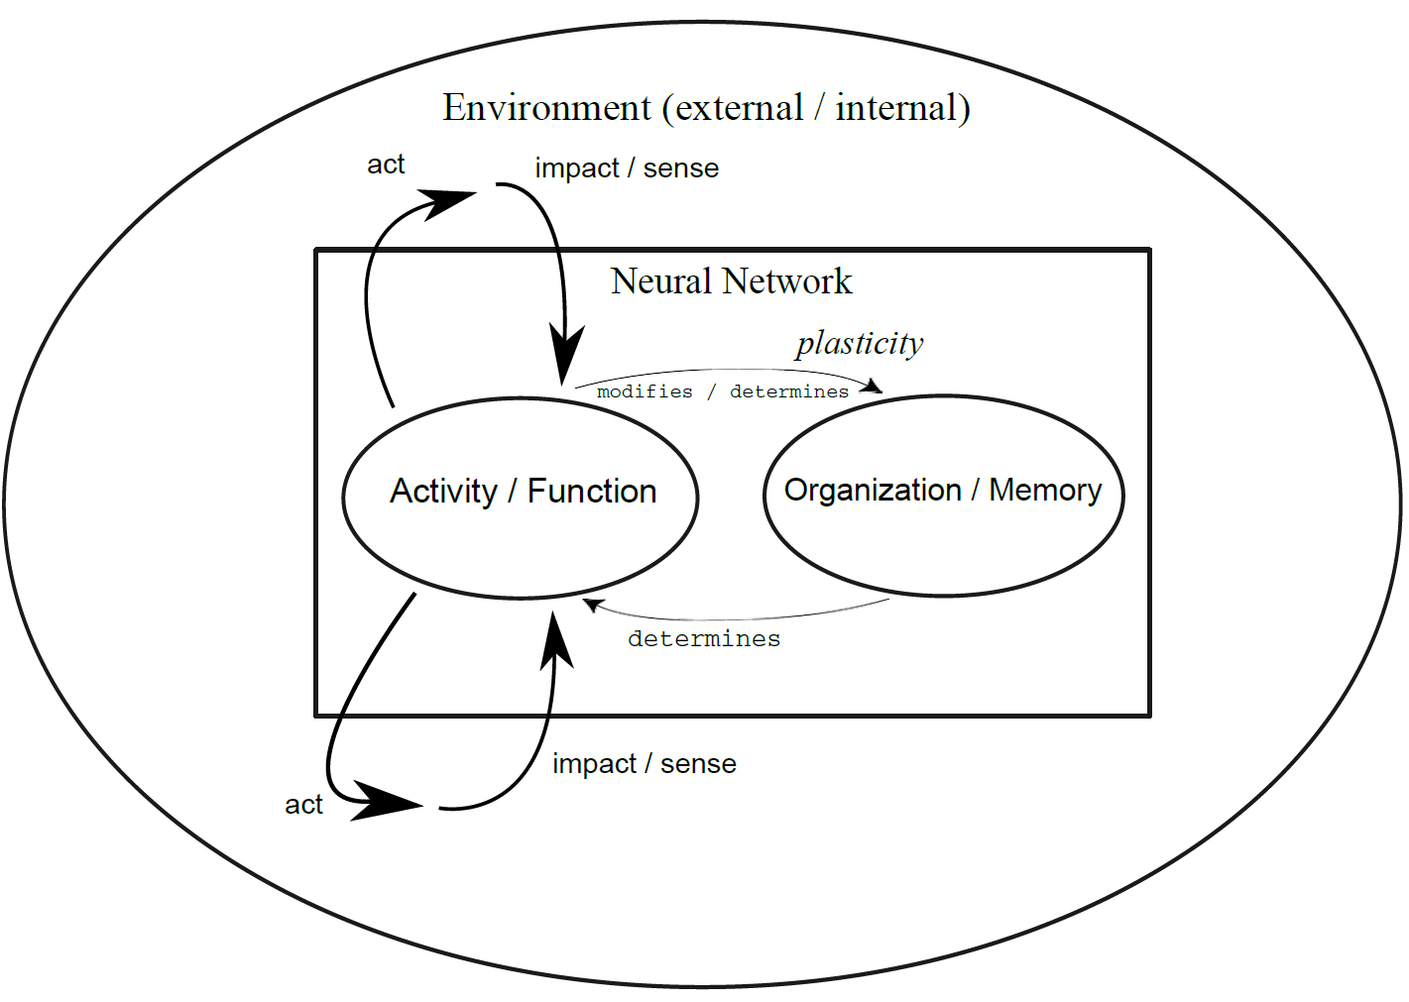
Environment, Organism and Plasticity

Slide 5
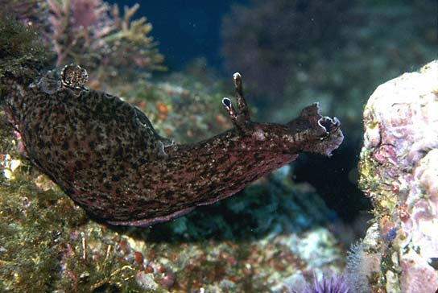
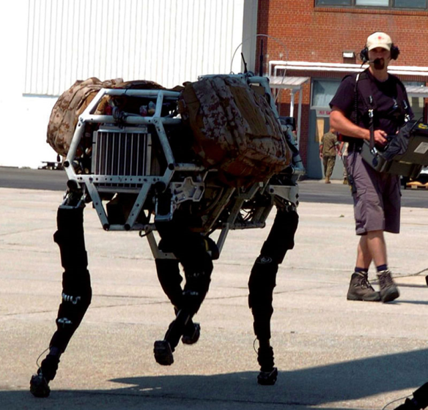
Adaptation and Learning in Biology
Adaptive, self-sustaining, autonomous
Assisted, engineered, non-autonomous

Slide 6
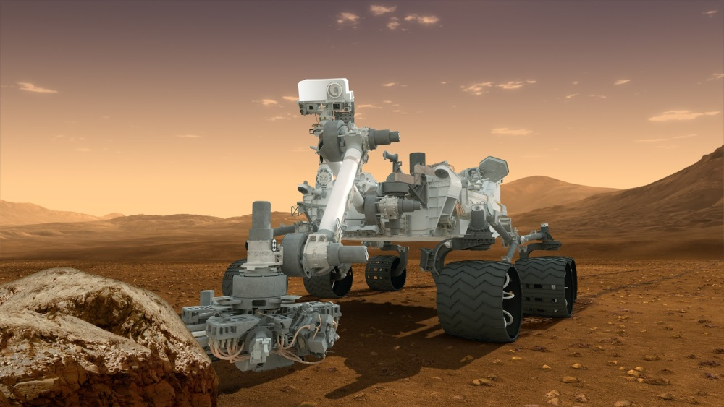
Adaptation and Learning in Biology
Adaptive, self-sustaining, autonomous
Assisted, engineered, non-autonomous

Slide 7

Adaptation and Learning in Biology
Adaptive, self-sustaining, autonomous
Assisted, engineered, non-autonomous

Slide 8
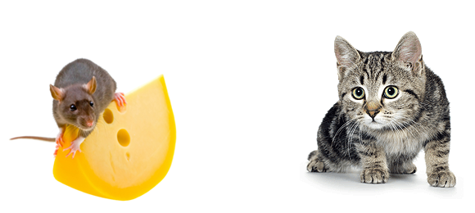
Adaptation and Learning in Biology
Maintaining long-term system's integrity and well-being

Slide 9
Adaptation and Learning in Biology
Predict the environment, act to gain benefit and avoid harm,
Adapt behavior from experience.
Loop forever and optimize.

Slide 10
Adaptation and Learning in Biology
Prediction, adaptation:
Probabilistic inference of own internal and world‘s model
from sensory experience
Iterative reduction of model prediction error
→ Plasticity, learning, memory (slow processes)

Slide 11
Adaptation and Learning in Biology
Decision making and action :
Neural dynamics of (near) optimal decision making (fast)
Neural dynamics of motor execution (fast)

Slide 12
Adaptation and Learning in Biology
A functional neural architecture :
Prediction, decision making, action and learning
→ Closed-loop : observe, predict, act, observe, adapt,
observe, predict, act, observe, adapt, …
What is the computational nature and objective of this loop?
Can we formalize it? Can we disassemble its neural substrate?

Slide 13
Environment, Organism and Plasticity
Brains “absorbs” information from the environment to improve organism's fidelity
Objective that maintains biological persistence : survive and produce off-spring in a changing environment
Prerequisites : competence about environment
Learning : extracting the information from the environment that is not yet incorporated in the nervous system
Plasticity : ability of the nervous system to change its properties (structure, organization), driven by network's own activity
Optimization : adapting information processing towards maximal benefit for the organism

Slide 14
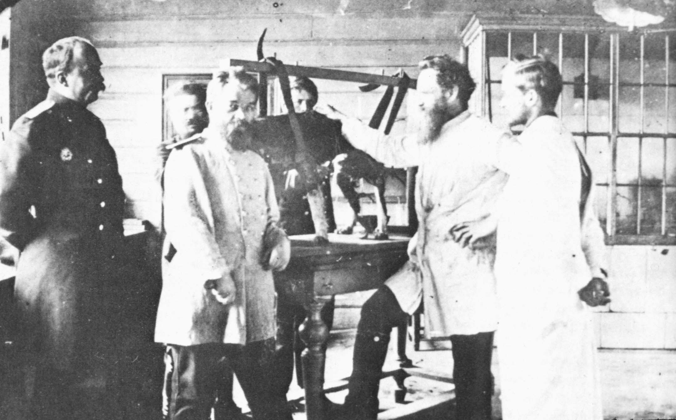
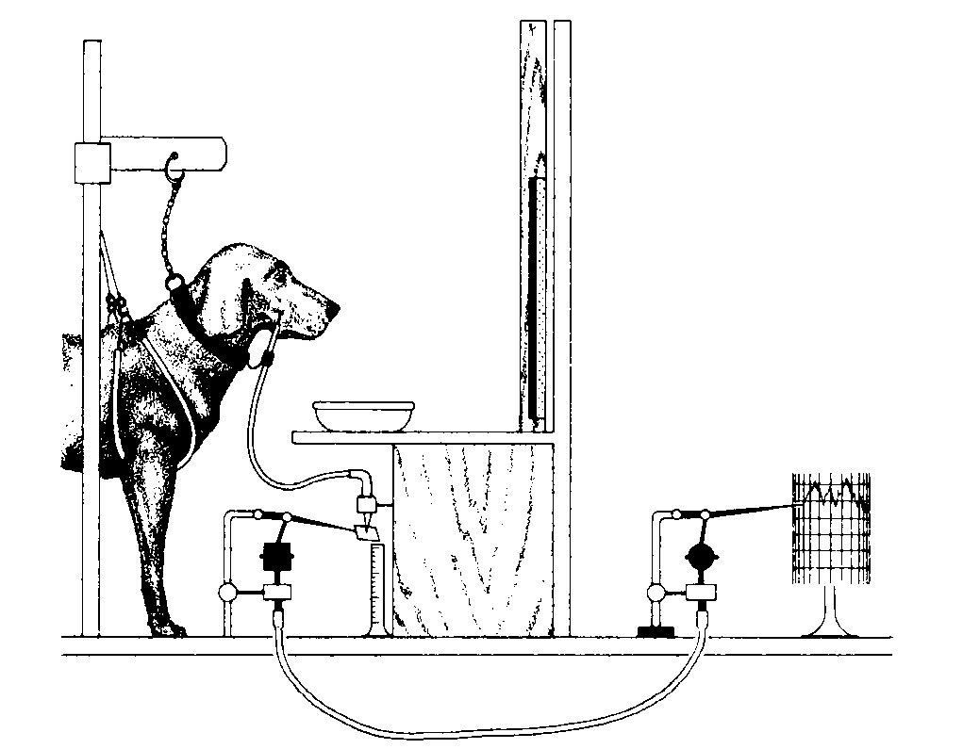
Different Forms of Biological Learning
Basic forms of learning (classical studies in behavioral psychology) :
Habituation (reduce of response to repetitive stimulus)
Sensitization (increase of response to repetitive stimulus)
Classical Conditioning (passive stimulus-reaction association)
Operant Conditioning (active stimulus-reaction association)
Pavlov Lab, around 1900

Slide 15
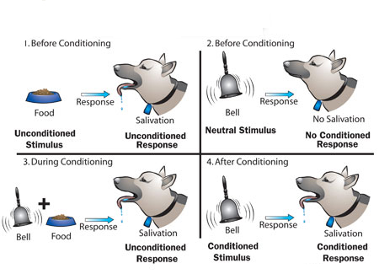
Different Forms of Biological Learning
Basic forms of learning (classical studies in behavioral psychology) :
Habituation (reduce of response to repetitive stimulus)
Sensitization (increase of response to repetitive stimulus)
Classical Conditioning (passive stimulus-reaction association)
Operant Conditioning (active stimulus-reaction association)

Slide 16
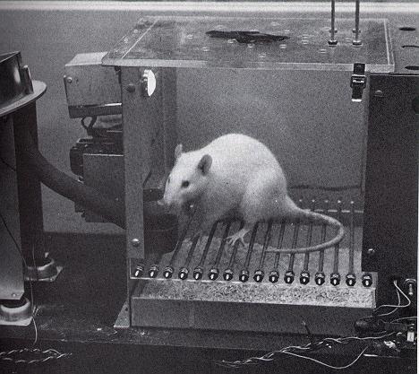
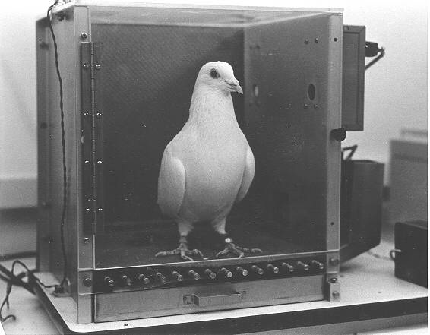
Different Forms of Biological Learning
Classical behavioral studies (Pavlov, Watson, Thorndike, Tolman, Skinner)
Shaping complex behavior by reward and punishment
Studying learning phenomena in rather simple setup
Neural substrates of adaptation were not accessible
Skinner boxes, around 1940 - 1950

Slide 17
Different Forms of Biological Learning
Pigeons learn to play pong by operant conditioning
Skinner Lab, around 1950

Slide 18
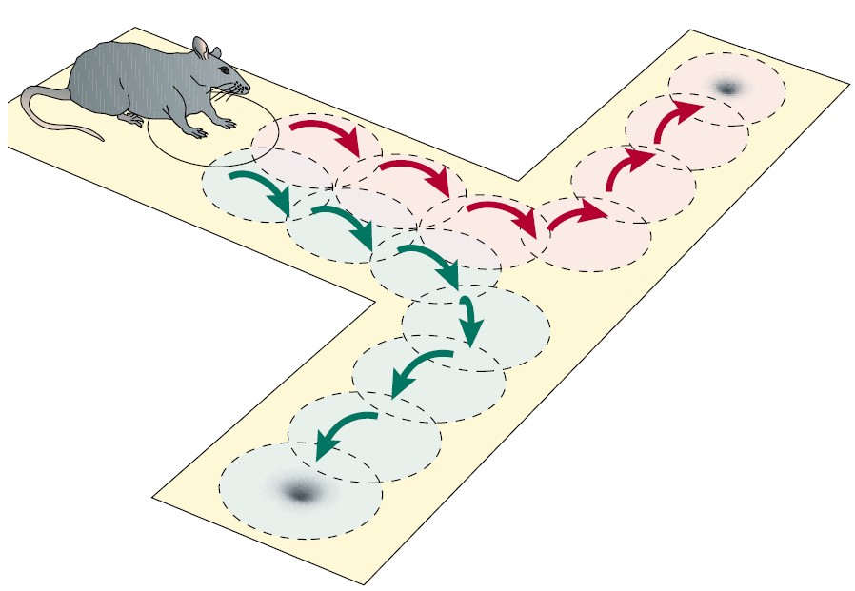
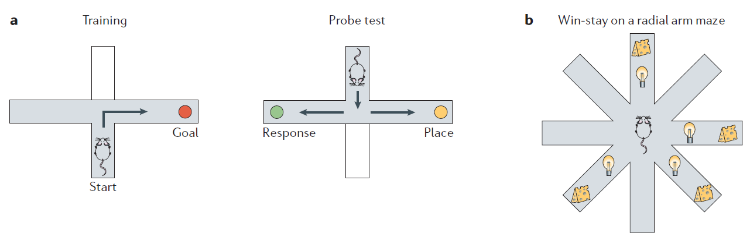
Different Forms of Biological Learning
Established experimental learning tasks : T-Maze, radial arm maze
Eichenbaum, 2000; Yin & Knowlton, 2006

Slide 19
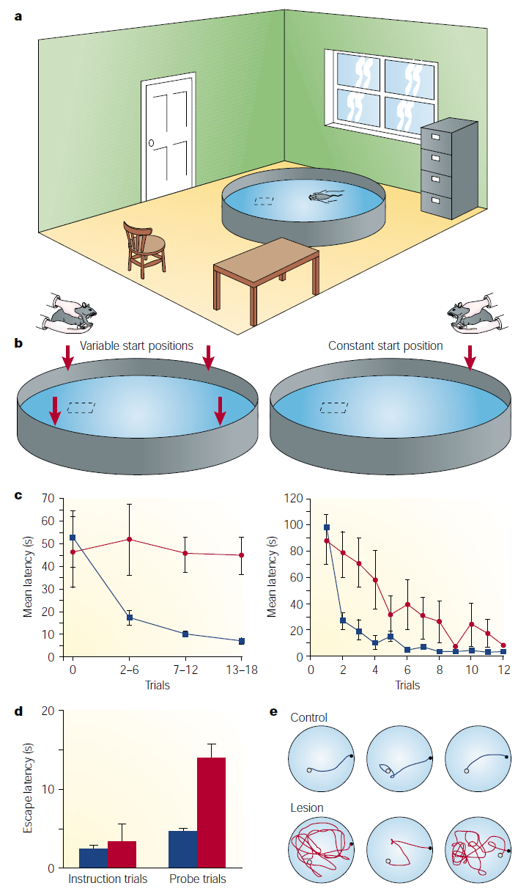
Different Forms of Biological Learning
Established experimental learning tasks : Morris water maze
Morris et al., 1982; Eichenbaum, 2000

Slide 20
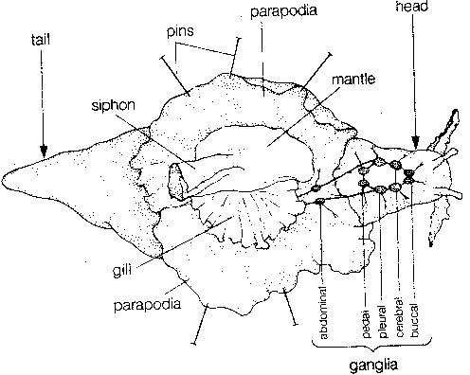
Neural Substrate of Learning : Plasticity
Basic forms of adaptation and learning, studied in Aplysia (sea slug)
Eric Kandel Lab (70's-00's, Nobel Prize in Medicine, 2000)
All basic forms of learning found in more complex organisms exist also here
Circa 20.000 Neurons
Cellular and molecular mechanisms revealed

Slide 21
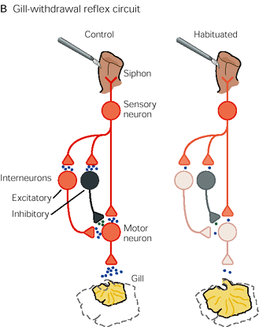
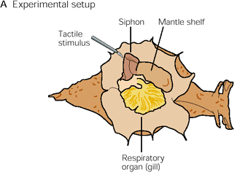
Neural Substrate of Learning : Plasticity
Basic forms of adaptation and learning, studied in Aplysia (sea slug)
Eric Kandel Lab (70's-00's, Nobel Prize in Medicine, 2000)
All basic forms of learning found in more complex organisms exist also here
Circa 20.000 Neurons
Cellular and molecular mechanisms revealed
Castellucci et al., 1978

Slide 22
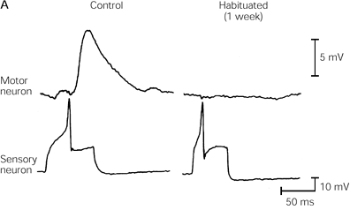
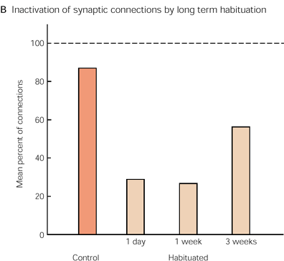
Neural Substrate of Learning : Plasticity
Basic forms of adaptation and learning, studied in Aplysia (sea slug)
Eric Kandel Lab (70's-00's, Nobel Prize in Medicine, 2000)
All basic forms of learning found in more complex organisms exist also here
Circa 20.000 Neurons
Cellular and molecular mechanisms revealed

Slide 23
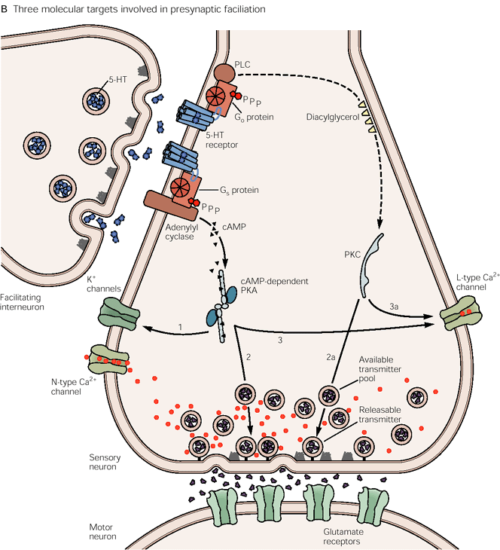
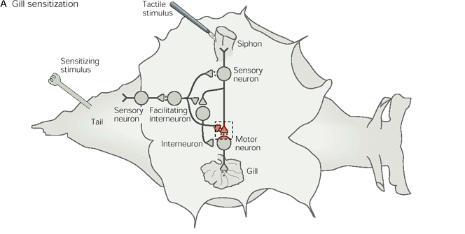
Neural Substrate of Learning : Plasticity
Basic forms of adaptation and learning, studied in Aplysia (sea slug)
Eric Kandel Lab (70's-00's, Nobel Prize in Medicine, 2000)
All basic forms of learning found in more complex organisms exist also here
Circa 20.000 Neurons
Cellular and molecular mechanisms revealed

Slide 24
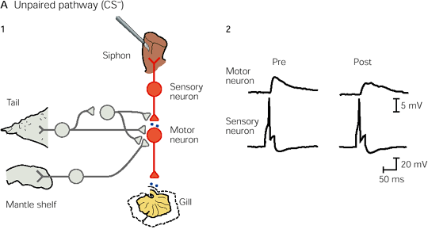
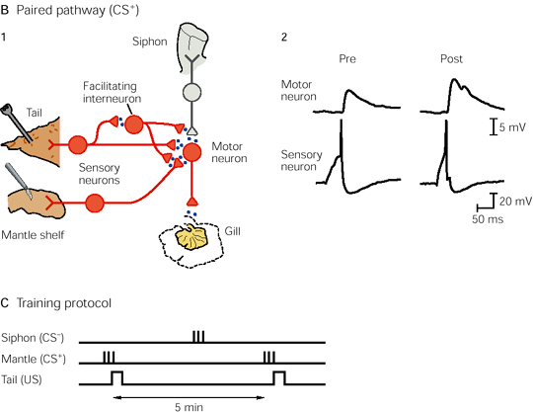
Neural Substrate of Learning : Plasticity
Basic forms of adaptation and learning, studied in Aplysia (sea slug)
Eric Kandel Lab (70's-00's, Nobel Prize in Medicine, 2000)
All basic forms of learning found in more complex organisms exist also here
Circa 20.000 Neurons
Cellular and molecular mechanisms revealed

Slide 25
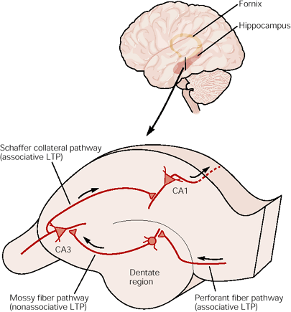
Neural Substrate of Learning : Plasticity
Plasticity has universal cellular and molecular mechanisms throughout the species

Slide 26
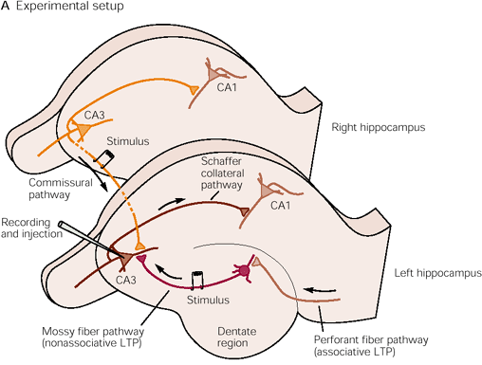
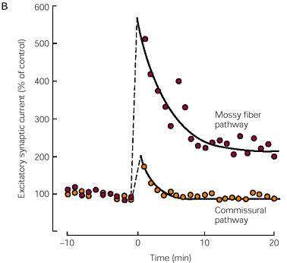
Neural Substrate of Learning : Plasticity
Plasticity has universal cellular and molecular mechanisms throughout the species (Induction of long-term potentiation, LTP)

Slide 27
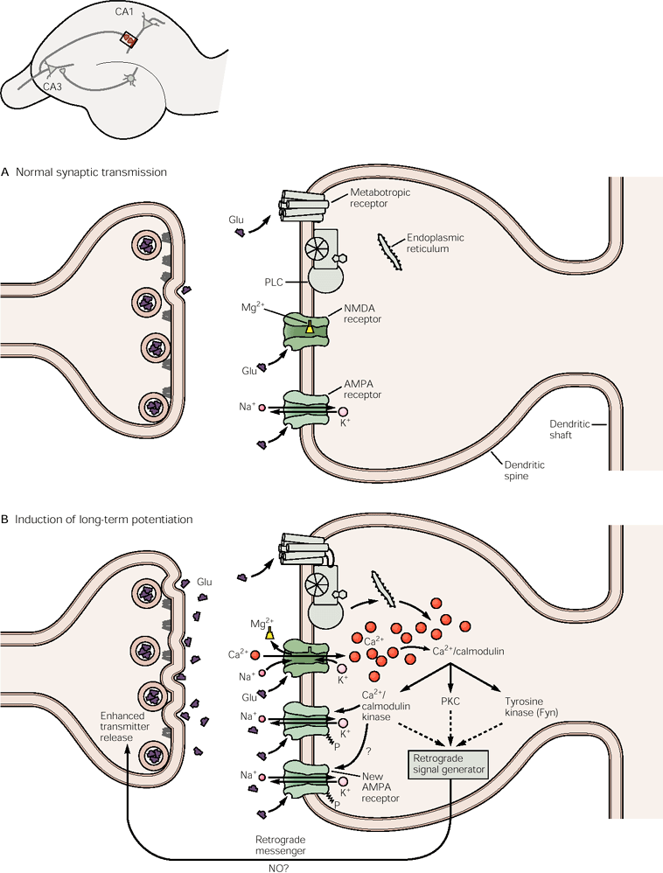
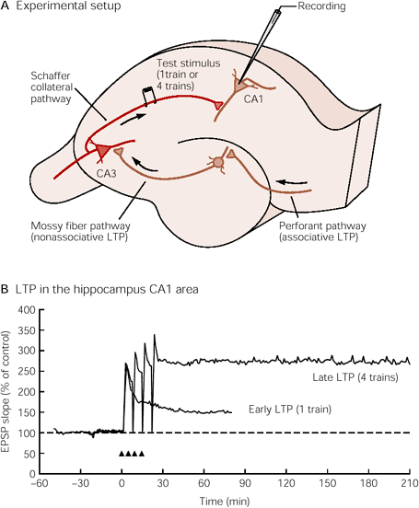
Neural Substrate of Learning : Plasticity
Plasticity has universal cellular and molecular mechanisms throughout the species

Slide 28
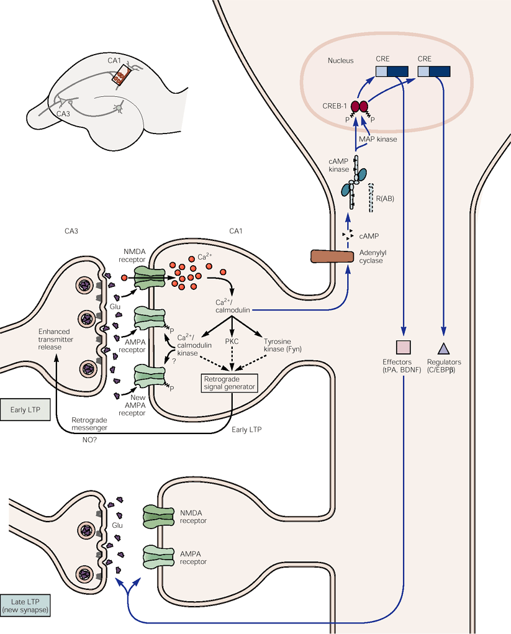
Neural Substrate of Learning : Plasticity
Plasticity has universal cellular and molecular mechanisms throughout the species

Slide 29

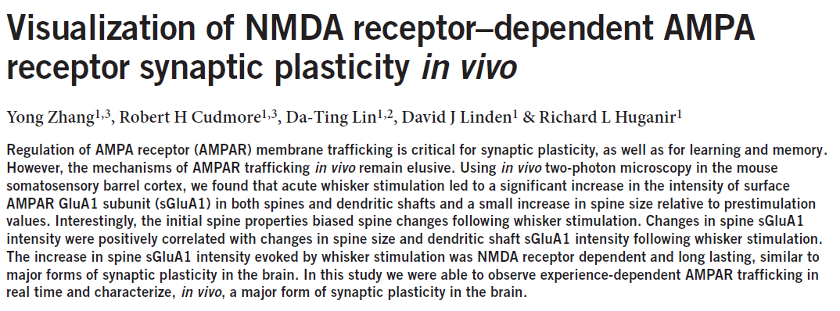
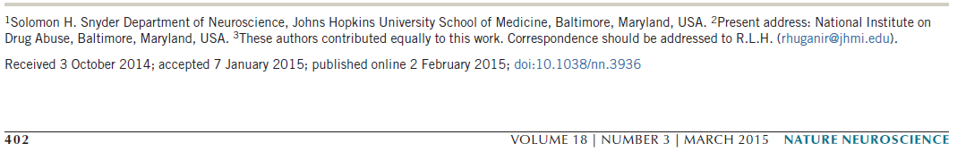
Neural Substrate of Learning : Plasticity
Plasticity has universal cellular and molecular mechanisms throughout the brain regions and species

Slide 30
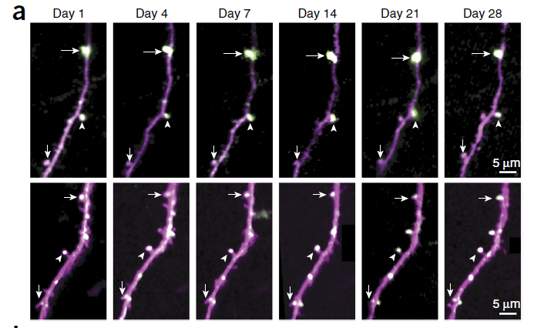
Neural Substrate of Learning : Plasticity
Measuring and visualizing AMPAR expression intensity in vivo (gene transfer into the embryonic mouse brain using in vivo electroporation, GFP labeled AMPAR subunits, two photon microscopy)

Slide 31
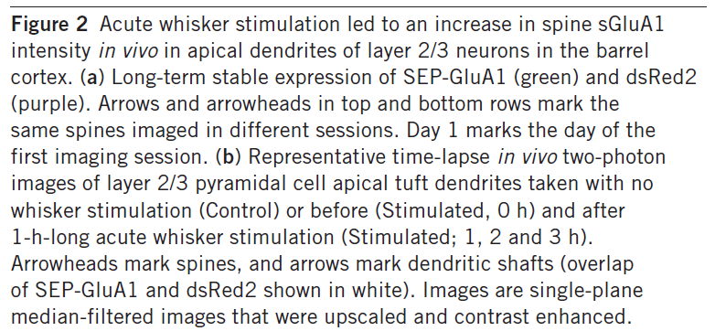
Neural Substrate of Learning : Plasticity
Plasticity has universal cellular and molecular mechanisms throughout the brain regions and species

Slide 32
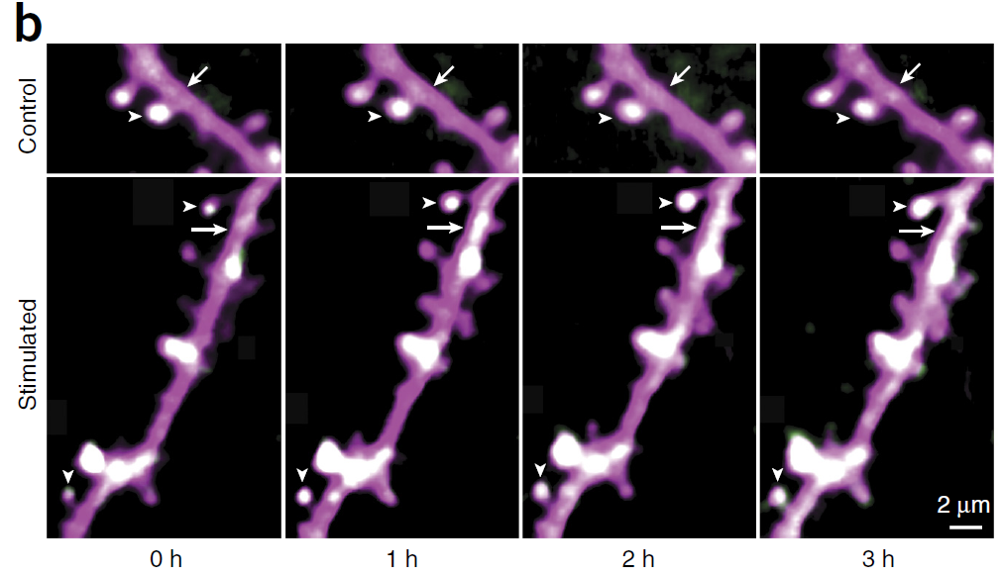
Neural Substrate of Learning : Plasticity
AMPAR intensity increases in specific synaptic location after stimulation; this change depends on NMDAR function

Slide 33
Neural Substrate of Learning : Plasticity
Plasticity can affect different sites in neuronal networks
Synaptic plasticity (synaptic LTP / LTD, STP / STD)
Dendritic plasticity (excitability changes, spine modification)
Somatic plasticity (excitability changes, receptor changes)
Structural plasticity (adding new synapses, spines or removing them)
Neurogenesis (adding or removing cells or fibres)

Slide 34
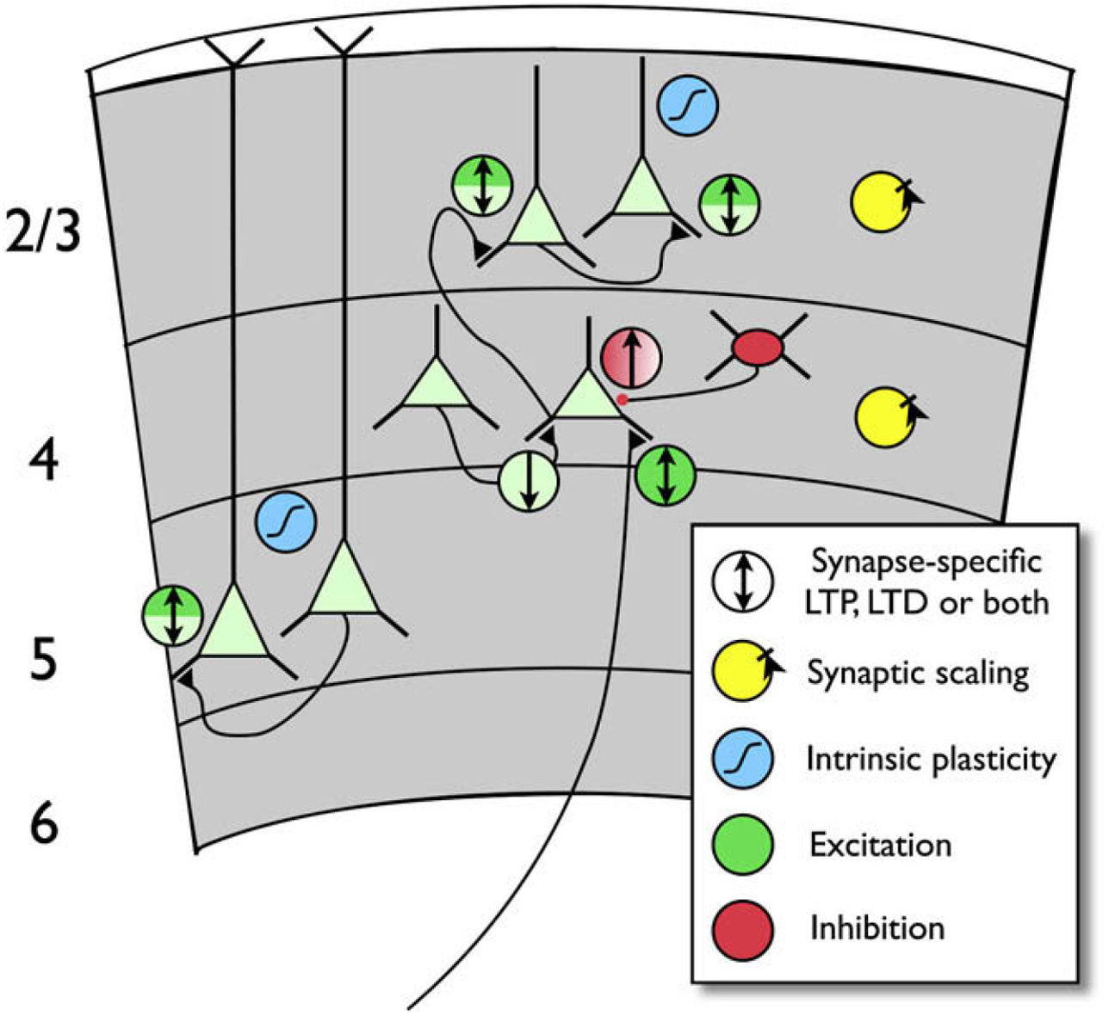
Neural Substrate of Learning : Plasticity
Plasticity can affect different sites in neuronal networks
Synaptic plasticity (synaptic LTP / LTD, STP / STD)
Dendritic plasticity (excitability changes, spine modification)
Somatic plasticity (excitability changes, receptor changes)
Maffei, Turrigiano, 2008

Slide 35
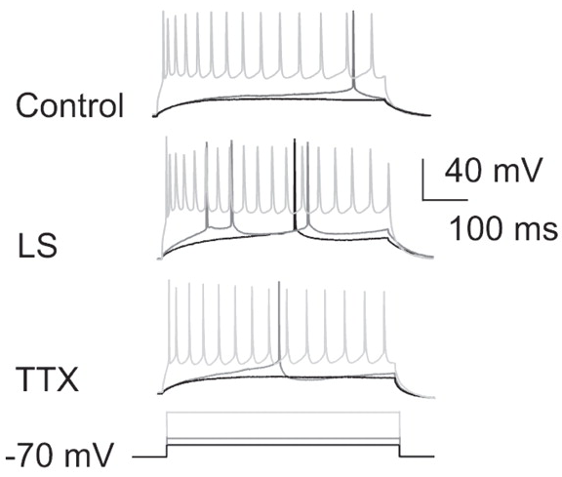
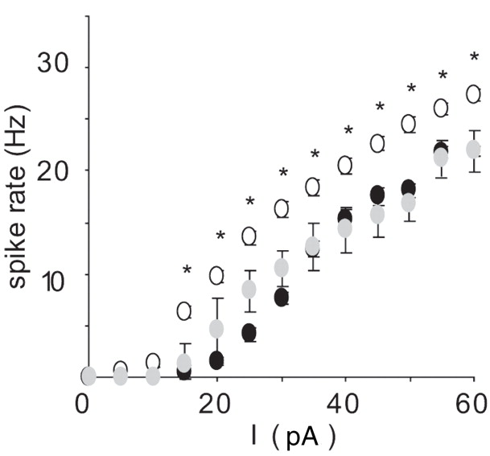
Neural Substrate of Learning : Plasticity
Intrinsic somatic plasticity is synapse-unspecific
Maffei, Turrigiano, 2008

Slide 36
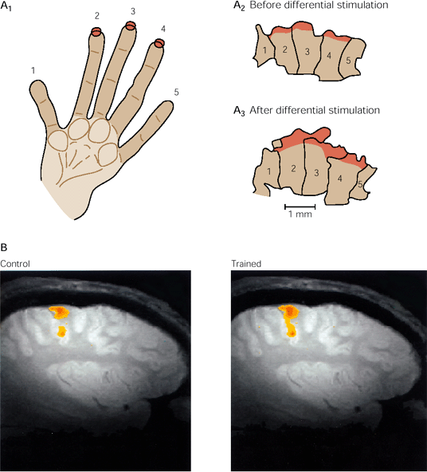
Neural Substrate of Learning : Plasticity
Local plasticity mechanisms and network system-level learning

Slide 37
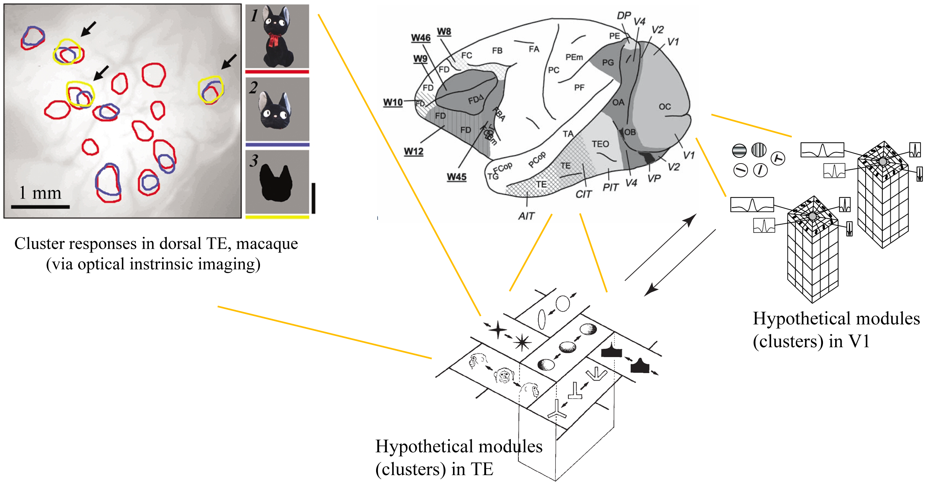
Neural Substrate of Learning : Plasticity
Local plasticity mechanisms and network system-level learning
DeValois, 1990; Tanaka, 1996, 2003; Tsunoda et al., 2001

Slide 38
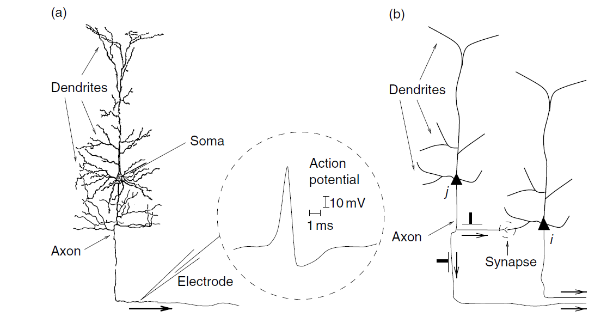
Mathematical models of neural plasticity

Slide 39
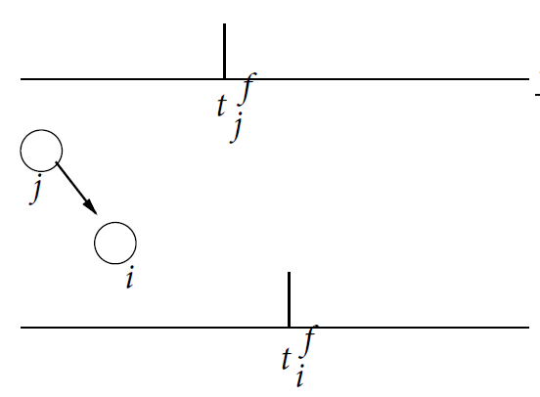


Neural Substrate of Learning : Plasticity
Locality of plasticity mechanism :
Do not forget important ingredient: dynamics of the neuron itself !
Generic form of a local synaptic plasticity rule:
where all variables are locally accessible at the synapse

Slide 40
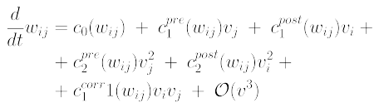






Neural Substrate of Learning : Plasticity
Taylor expansion gives all possible local terms:
Any specific synaptic plasticity rule can be derived from this generic form
Standard Hebb (fire together – wire together):
Hebb with decay:
Hebb with LTP/LTD threshold:
Covariance rule:
Bienenstock-Cooper-Monro (BCM):
etc
,

Slide 41
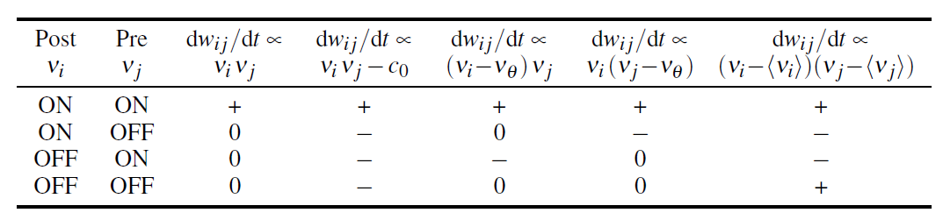
Neural Substrate of Learning : Plasticity
Usage of pre- and post variables in terms defines the direction of synaptic change (potentiation, LTP, depression, LTD, or none)

Slide 42

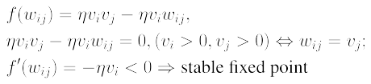
Neural Substrate of Learning : Plasticity
Stability analysis : determining stable synaptic weight configurations given a particular rule
A simple example : Hebb like rule with weight dependance.
Weights converge to presynaptic activities vj (vj are fixed, stable points of
the synapic modification)

Slide 43
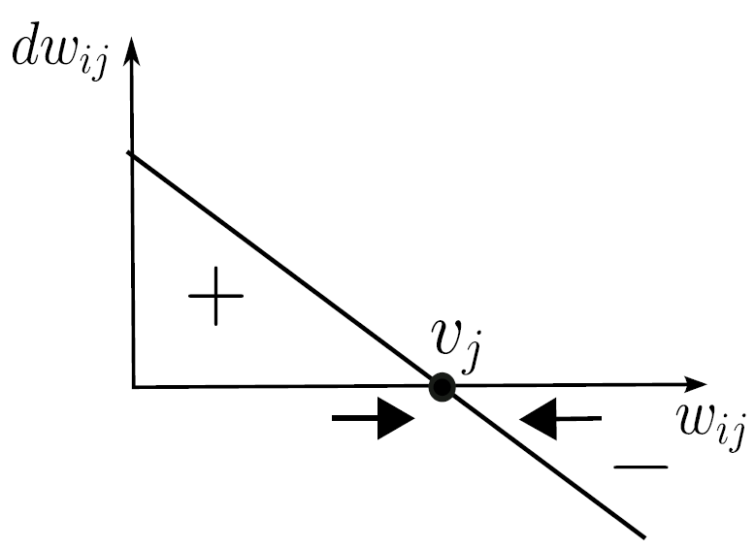
Neural Substrate of Learning : Plasticity
Stability analysis : determining stable synaptic weight configurations given a particular rule
A simple example : Hebb like rule with weight dependence
Weights converge to presynaptic activities vj (vj are fixed, stable points of
the synapic modification)

Slide 44

Neural Substrate of Learning : Plasticity
Stability analysis : determining stable synaptic weight configurations given a particular rule
A more advanced example : inferring weight distribution from the type of
synaptic modification rule
Depending on form of weight dependence (regulated by β), weight distribution can become
Bimodal for additive weight dependence (β = 0 : strong competition between the weights, weights either very strong or very weak)
Unimodal for multiplicative weight dependence (β = 1 : weak competition between the weights, intermediate values are possible)

Slide 45
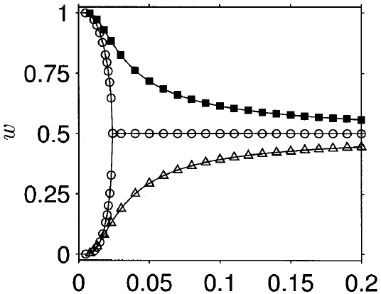
Neural Substrate of Learning : Plasticity
Stability analysis : determining stable synaptic weight configurations given a particular rule
A more advanced example : inferring weight distribution from the type of
synaptic modification rule
Gütig et al, 2003

Slide 46
Neural Substrate of Learning : Plasticity
Phenomenological or functional plasticity rules
Reproduce
phenomena observed in a neurophysiological experiment), or
a function / computation that is able to do information processing / learning in a defined task
or ideally both

Slide 47

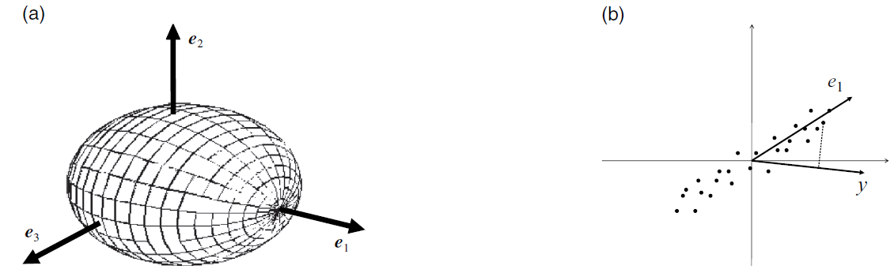
Neural Substrate of Learning : Plasticity
Oja rule (Oja, 1982) : LTP or LTD depending on pre, post and the current synaptic weight
No experimental support
Self-stabilizing rule : synaptic weights are self-normalized and cannot grow without bounds
Unsupervised learning : formally equal to Principal Component Analysis (PCA → provides a mean to perform dimensionality reduction)

Slide 48
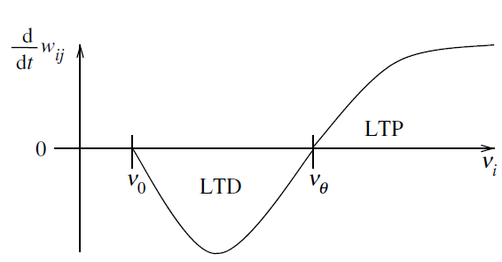
Neural Substrate of Learning : Plasticity
BCM (Bienenstock-Cooper-Monroe, 1982) : sliding threshold (modified by previous history of activation) separating LTP / LTD zones
Experimentally supported (visual cortex plasticity during early development, monocular / binocular deprivation experiments)
Unsupervised learning : development of input selectivity (receptive field formation)
Relation to projection pursuit, function / density approximation

Slide 49
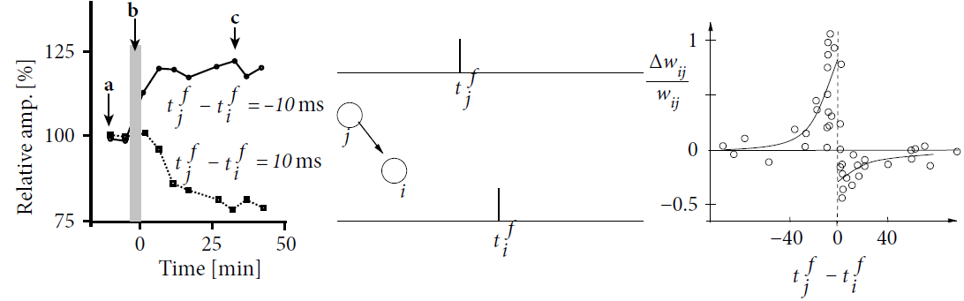
Neural Substrate of Learning : Plasticity
Spike timing dependent plasticity (STDP) family of rules : take
into account explicitly the time of spikes tj ,ti on pre and post synaptic sides
Experimental support that timing often matters, but no experimental support for universal synaptic plasticity based on timing only
Unsupervised learning : development of input selectivity, receptive field formation, Independent Component Analysis (ICA), etc
Markram et al, 1997

Slide 50


Neural Substrate of Learning : Plasticity
Spike timing dependent plasticity (STDP) family of rules : pair- based form, taking only spike pairs into account

Slide 51

Neural Substrate of Learning : Plasticity
Spike timing dependent plasticity (STDP) family of rules : however, in experiments you can generate almost arbitrary forms of modification that do not fit any pair-based spike timing only scheme

Slide 52

Neural Substrate of Learning : Plasticity
Spike timing dependent plasticity (STDP) family of rules : however, in experiments you can generate almost arbitrary forms of modification that do not fit any pair-based spike timing only scheme

Slide 53

Neural Substrate of Learning : Plasticity
Spike timing dependent plasticity (STDP) family of rules : however, in experiments you can generate almost arbitrary forms of modification that do not fit any pair-based spike timing only scheme

Slide 54

Neural Substrate of Learning : Plasticity
Spike timing dependent plasticity (STDP) family of rules : however, in experiments you can generate almost arbitrary forms of modification that do not fit any pair-based spike timing only scheme

Slide 55

Neural Substrate of Learning : Plasticity
Spike timing dependent plasticity (STDP) : timing is not everything, other factors are at least as important
→ too simple synaptic plasticity rules may be just wishful thinking
Voltage-dependent STDP, Clopath et al, 2010 : example of an attempt to correct pure STDP by taking into account further variables

Slide 56

Neural Substrate of Learning : Plasticity
Understanding plasticity requires a good guess of the objective of learning : synaptic changes occur under very diverse conditions, without an idea what information processing may stay behind them, one gets lost in this diversity.

Slide 57
Neural Substrate of Learning : Plasticity
System level learning : what does the neural network with changing synapses trying to do?
DeValois, 1990; Tanaka, 1996, 2003; Tsunoda et al., 2001

Slide 58

Neural Substrate of Learning : Plasticity
Unsupervised learning in network of winner-take-all (WTA) circuits
Jitsev and von der Malsburg, 2009, 2010; Jitsev, 2014

Slide 59

Neural Substrate of Learning : Plasticity
Unsupervised learning in network of winner-take-all (WTA) circuits
Jitsev and von der Malsburg, 2009, 2010; Jitsev, 2014

Slide 60
Neural Substrate of Learning : Plasticity
System level learning : formalize objective of the learning as an optimization that seeks to maximize organisms well-being
→ maximize “reward”, minimize “punishment”
→ To do that, it is necessary to develop ability to predict upcoming events in the environment
→ To do that, it is necessary to build a model what organism's actions may cause in the environment

Slide 61
Neural Substrate of Learning : Plasticity
"What is painful is avoided and what is pleasant is pursued."
(Aristotle, De Motu Animalium, 400 B.C.)

Slide 62
Neural Substrate of Learning : Plasticity
Predict the environment and act to gain benefit and avoid harm

Slide 63
Neural Substrate of Learning : Plasticity
A functional neural architecture:
Sense and Predict : internal model and outcome expectations
Act : (near) optimal decision making (based on expectations)
Learn : improve to get more reward and less punishment

Slide 64

A functional model of reinforcement learning
Barto et al, 1983; Niv et al, 2006

Slide 65


Bellman equations
Bellman equations : mathematical foundation for optimizing decision making and behavior
A value function V(s) describes expected outcome
(given a policy for action selection)
Optimal value function provides best possible outcome
Barto et al, 1983; Niv et al, 2006

Slide 66





Temporal Difference (TD) learning
Learning driven by the prediction error signal
Computing prediction error (difference between
internal expectation and the following observation)
: better than expected
: worse than expected
Updating expectations and action preferences
Barto et al, 1983; Niv et al, 2006

Slide 67


Learning and prediction error
Before learning : unpredicted outcome
After learning : predicted outcome

Slide 68

Temporal Difference (TD) learning
Learning driven by the prediction error signal
Updating expectations and action preferences
Decision making and action selection based on
learned preferences (Bolzmann distribution, soft max)
Barto et al, 1983; Niv et al, 2006

Slide 69

A functional model of reinforcement learning
Instantiation of temporal-difference (TD) learning : Actor-critic architecture
Barto et al, 1983; Sutton and Barto, 1998

Slide 70

A functional model of reinforcement learning

Slide 71

A functional model of reinforcement learning

Slide 72

A functional model of reinforcement learning

Slide 73

A functional model of reinforcement learning

Slide 74

A functional model of reinforcement learning

Slide 75

Basal Ganglia and Reward-Based Learning
Made by BodyParts3D, Integrated Database Project, MEXT, Japan

Slide 76

Basal Ganglia and Reward-Based Learning
−
−
Purves et al, Neuroscience, 3ed, 2003

Slide 77

Basal Ganglia and Reward-Based Learning
−
−

Slide 78

Dopamine and Reward-Based Learning
−
−
Schulz et al, 1997

Slide 79

Basal Ganglia and Reward-Based Learning
−
−
Lei et al., 2004; Morishima & Kawaguchi, 2006; Reiner et al., 2010

Slide 80

Basal Ganglia and Reward-Based Learning
−
−
Pawlak et al,, 2010

Slide 81

Basal Ganglia and Reward-Based Learning
−
−

Slide 82

Basal Ganglia and Reward-Based Learning
Bidirectional plasticity on D1 MSN synapses.
(DA low : LTD; DA high : LTP)
−
−
−
−
Shen et al,, Science, 2008

Slide 83

Basal Ganglia and Reward-Based Learning
Bidirectional plasticity on D2 MSN synapses.
(DA low : LTP; DA high : LTD)
−
−
Shen et al,, Science, 2008

Slide 84
Neural Substrate of Learning : Plasticity
Learning driven by the prediction error signal
→ Hypothesis : Dopamine represents prediction error and
modulates plasticity
Computing prediction error (difference between
internal expectation and the following observation)
: better than expected
: worse than expected
Updating expectations and action preferences
Barto et al, 1983; Niv et al, 2006

Slide 85
Dopamine and Reward-Based Learning
−
−
Schulz et al, 1997

Slide 86

Basal Ganglia and Reward-Based Learning
−
−
Doya, 2002

Slide 87
Basal Ganglia and Reward-Based Learning
−
−

Slide 88

Basal Ganglia and Reward-Based Learning
−
−
Jitsev et al,, 2012

Slide 89

Basal Ganglia and Reward-Based Learning
−
−
Jitsev et al,, 2012

Slide 90

A functional model of reinforcement learning
−
−
Jitsev et al,, 2012

Slide 91


A functional model of reinforcement learning
−
−

Slide 92

A functional model of reinforcement learning
Winner-take-all (WTA) circuitry used in actor part for action-selection
−
−

Slide 93

A functional model of reinforcement learning
Winner-take-all (WTA) circuitry used in actor part for action-selection

Slide 94

A functional model of reinforcement learning

Slide 95
A functional model of reinforcement learning
Winner-take-all (WTA) circuitry used in actor part for action-selection

Slide 96
A functional model of reinforcement learning

Slide 97

A functional model of reinforcement learning

Slide 98

A functional model of reinforcement learning

Slide 99

A functional model of reinforcement learning

Slide 100

A functional model of reinforcement learning

Slide 101

A functional model of reinforcement learning

Slide 102

A functional model of reinforcement learning

Slide 103


A functional model of reinforcement learning
Weidel et al., CNS 2015

Slide 104
A functional model of reinforcement learning
People involved
Kenji Morita, University of Tokyo (Time and Reward)
Boris Gutkin, ESN & CNRS, Paris (Nature of Reward Signal)
Philipp Weidel, Susanne Kunkel, Abigail Morrison (Plasticity, Learning, Representation, Neural Coding)

Slide 105
Adaptation and Learning in Biology
The core feature of adaptivity is updating internal model (expectations, beliefs) in face of experience (consequences) → Learning
Experience (sensory input) is able to change organization of brain's neural networks → Plasticity
Plasticity implements learning in yet unknown way
Figuring it out would mean a breakthrough both in understanding the brain and in creating new technology

Slide 106

Adaptation and Learning in Biology
Just do it.

Slide 107


